Slide 1

Globally Scalable Resilient Application using Azure Gagan Singh Pankaj Satyaketu

Slide 2
Table of Contents
1. Architecture
2. Demo
3. Azure DevOps

Slide 3
1. Architecture of eshop on containers 2. Demo 3. Azure DevOps

Slide 4
Demo Background
Deploy an e-commerce application on containers in a multi-region setup using Azure DevOps
Components of the application include but not limited to :
Azure Cosmos DB
Azure SQL DB
Azure Kubernetes Service (AKS)
Azure Service Bus
Azure Redis
.NET Core 2.x
Microservices Architecture
The demo will leverage Azure DevOps to build and deploy the e-commerce application
Demonstrate geo-stretched active-active application resiliency

Slide 5
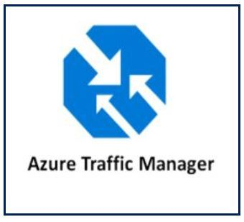
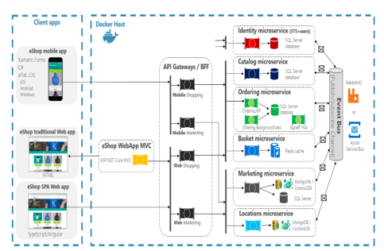
Multi – Region Architecture
US EAST
US WEST
Notes:
Own set of databases and Own set of service bus queues
Each of service bus is a topic ; one of the subscriptions is an integration subscription
Topic = Queue ; create subscriptions under queue and each API Subscribes to one of the queues
This application uses topics
For price change message push message in the service bus topic. Every subscription gets a copy of that message and every subscription looks at the message and sees if in my API do I care of the price changes ; If the API cares for the price change
Replication is only from east to west
This model is for eventual consistency
Only process one message at a time and no parallel processing

Slide 6


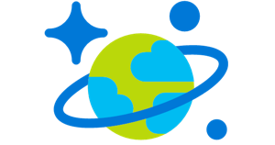
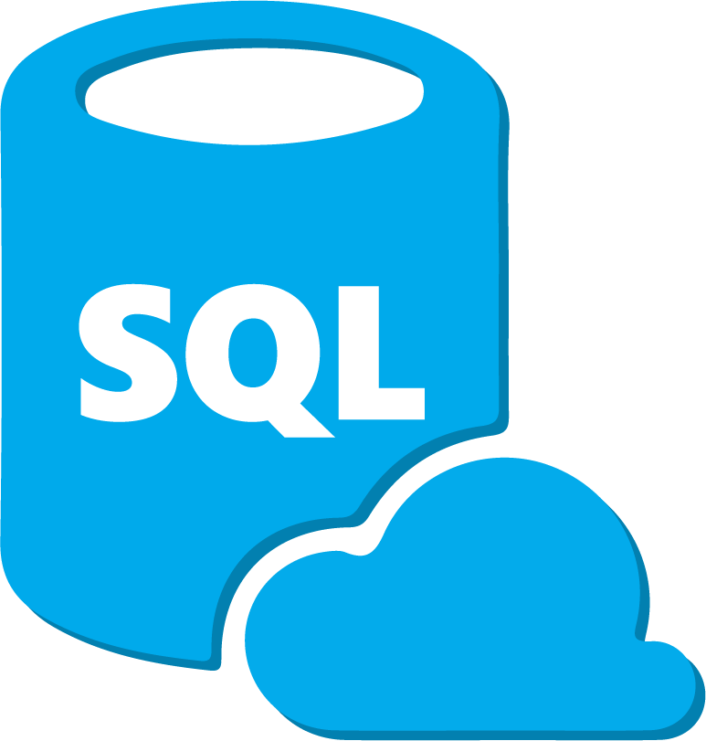
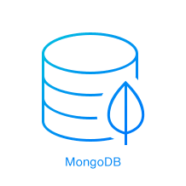

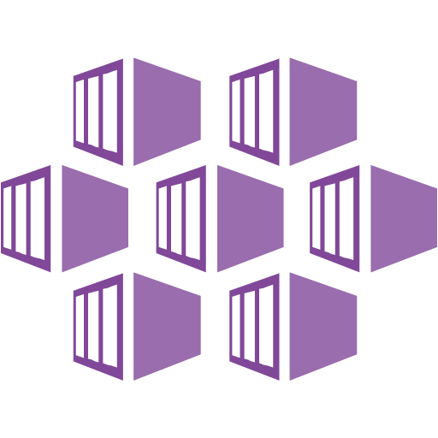
Multi Region Architecture
Price Change App
(Not Deployed in Demo)
East US
West US
Basket
Catalog
…
Replicate to West
Basket
Catalog
…
Replicate to East
API
API
API
API
API
API
Location
Marketing
Catalog
Catalog
Location
Marketing
Notes:
There are several Subscriptions deployed as part of the solution
We will take a look at replicating Price Change.
Every Subscription receives the Price change message
APIs look to see whether they care about Price change message
Individual applications can be changed and it’s container redeployed without have to change the entire application.
For simplicity, MongoDB and SQL in containers were used for the Demo, however it is a connection string change to deploy to native PaaS solution
Why not CosmosDB MultiMaster
MultiMaster implemented at the App Tier, can leverage any backend store.
Why MongoDB
Development was done with MongoDB as there is no way to run CosmosDB within a container on Linux. You could run the emulator on Windows, however Docker has a limitation on all containers have to be Windows or Linux

Slide 7
Replicating Price Changes as an Example
Price Change App
East US
West US
Basket
Catalog
…
Replicate to West
Basket
Catalog
…
Replicate to East
API
API
API
API
API
API
Notes:
Price Change App Submits Message changing Price from 18.50 -> 19.50 to Service Bus
Published to all Subscriptions.
APIs for the services reside in Containers and connected to the subscriptions. The APIs have logic to determine if it needs to take action on the message. In this scenario, Catalog and Replicate to West APIs will take action
Catalog checks to see what the current price is. If the current price is not set to the price in the message it updated the databases. A service (running on laptop for now) subscribes to the Replicate to West
Subsequently the Catalog API sends a new message back to service bus saying that the price changed
Catalog API receives the message and says my price is already 19.50 I’m done processing. This is an example of the IDEMPOTENT messaging pattern where you for example only want to say what the new price is, not add a dollar. Keep processing until the price is 19.50

Slide 8
E-Books
NET-Microservices-Architecture-for-Containerized-NET-Applications – Introduction guide to develop microservices based architecture and managing them using containers
Containerized Docker Application Lifecycle with Microsoft Platform and Tools – End to End guidance for application development lifecycle on containers

Slide 9
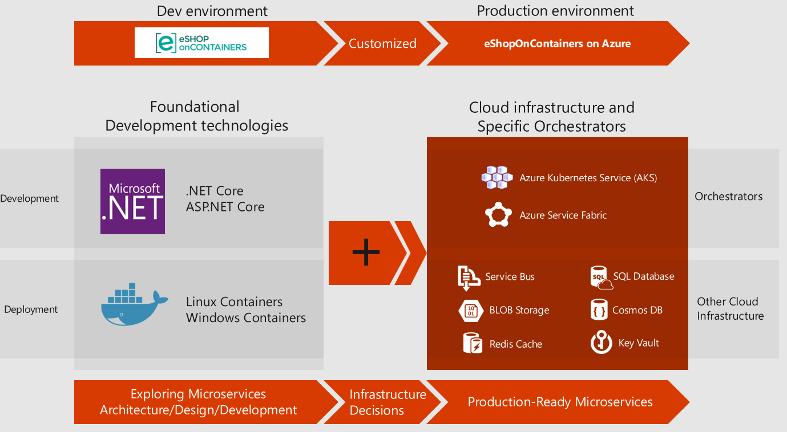
Lifecycle Management
Notes:
Most enterprises today are employing tools and processes to achieve development efficiencies and increase build/deployment velocity
Azure DevOps provides full lifecycle management and is native to the Azure platform. Azure DevOps has Git based repos and creates build and release pipelines to supports deployments on private and public deployments)
For this demo the development framework is ASP.NET Core and .NET Core . Docker deployments provides flexibility for development on Docker on Windows/Linux/Mac. Developers can develop and test locally on their workstation
We are using AKS to provide our container clusters. AKS is a fully managed Kubernetes as a service provided by Azure. For this demo we have clusters in US EAST and US WEST
Polyglot persistence is provided by containers in development (developers workstation) and Azure PaaS services for a production like scenario (examples include SQL Databases and Cosmos DB)
Key vault - Secure key management, Azure Key Vault to encrypt keys and small secrets like passwords that use keys stored in hardware security modules (HSMs). For more assurance, import or generate keys in HSMs, and Microsoft processes your keys in FIPS 140-2 Level 2 validated HSMs (hardware and firmware) – Not Demo’ed

Slide 10
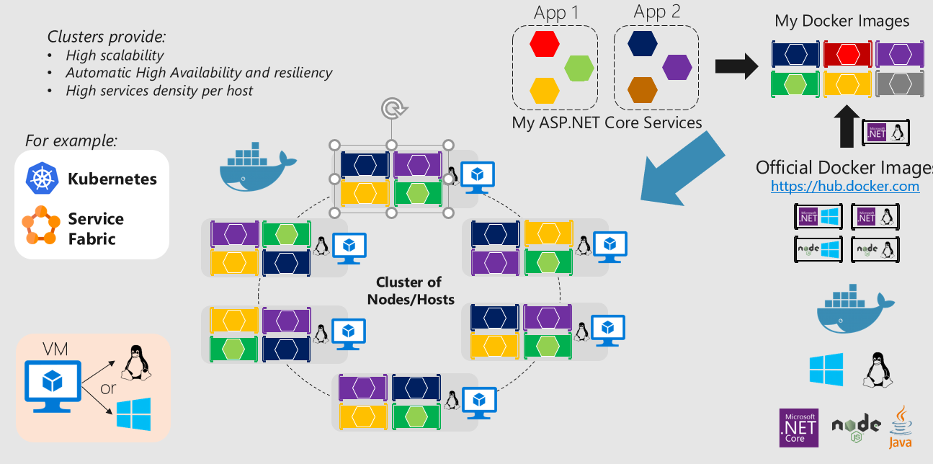
Container Orchestrators
Notes:
For this demo each service ( such as catalog service/pricing service) is deployed on its own containers in a replica set. Since the containers are deployed in a container set we can define scaling rules to scale containers up/down based on demand
Containers are “units of deployment”
Azure container registry is leveraged to store images. Azure Container Registry allows you to build, store, and manage images for all types of container deployments (Private Docker container registry as a service)
AKS provisioned and managed clusters.
Summary benefits
Agile application creation and deployment
Continuous development, integration and deployment
Create application container images at build/release time rather than deployment time
Cloud and OS distribution portability

Slide 11
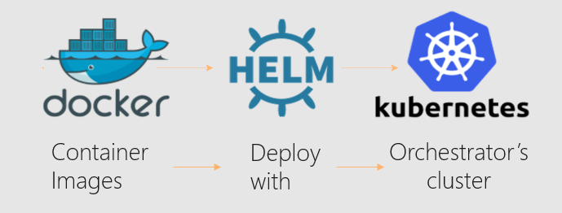
Kubernetes and Helm
Helm is THE package manager for Kubernetes:
…Kubernetes deployments with just Kubectl.exe and .yml files are not standard but custom & complex…
Helm improves:
Makes application deployment easy, standard and reusable
Easy application install, update, rollback & removal. Packages are declaratively defined in Helm Charts
Charts can be shared and publicly published (https://github.com/helm/charts/tree/master/stable)
Designed with versioning of packages in mind
You need Helm if you want to use Azure DevSpaces! :) (Azure DevSpaces is not demo’ed)
A rapid, iterative Kubernetes development experience for teams
Video
Notes:
ACR now supports Helm charts and can be used to deploy HELM charts to AKS.
Not in sample but can be extended
https://docs.microsoft.com/en-us/azure/aks/kubernetes-helm#configure-helm
Sample:
INSTALL AN EXAMPLE CHART
To install a chart, you can run the helm install command. Helm has several ways to find and install a chart, but the easiest is to use one of the official stable charts.
$ helm repo update # Make sure we get the latest list of charts
$ helm install stable/mysql

Slide 12
1. Architecture of eshop on containers 2. Demo 3. Azure DevOps
Notes:
Prep
Open sites:
104.46.101.39 www.eshopeast.com
13.66.215.218 www.eshopwest.com
Launch EastWestSynch
Navigate to UpdatePrice from command line
Launch Azure DevOps https://dev.azure.com/FSIUSCSU/East%20West%20Containers
Demo Steps
Gagan will showcase DevOps
Show Websites (west and west)
Run UpdatePrice: .\UpdateItemPriceInEast.exe 2 10.00 WITHOUT SYNC SERVICE Running
Start Synch Service
Show price change
Show output from Synch Service
Show resources in Azure Portal
Drill into Service Bus NameSpace
List the various Topics
Dive into App Insights
Server Response Time -> Top Operation -> Drill Into -> Top 3 Dependancies

Slide 13
1. Architecture of eshop on containers 2. Demo 3. Azure DevOps

Slide 14

Lifecycle
Source control
CI/CD pipeline
Manual Approval
Kube apply
Deployments.yaml
Kube apply
Deployments.yaml
git commit
git push
Container registry
Lisa
DEV
cluster
Production
cluster
'up' or F5 debug
values.dev.yaml
Lisa
Cesar
Cesar
John
John
AKS cluster
Notes:
Run or debug code prior to committing in a production-like development environment running in Azure
Work with real upstream and downstream dependencies instead of mocks or simulators
Use a shared team environment with isolated spaces to avoid complex setup and enable live, ongoing discovery of integration issues

Slide 15
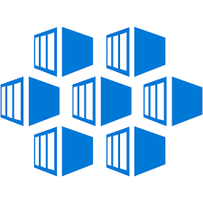
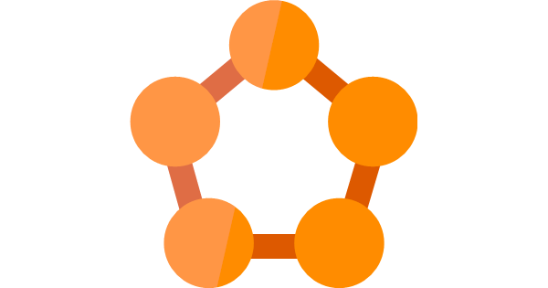

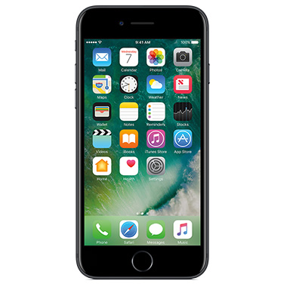

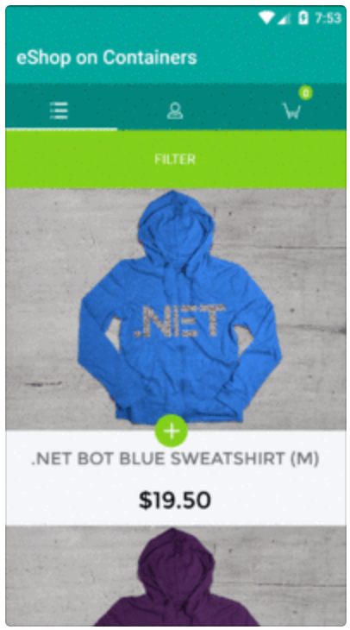
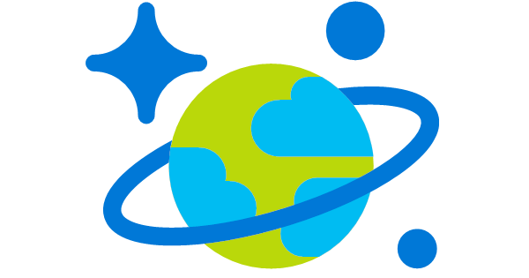
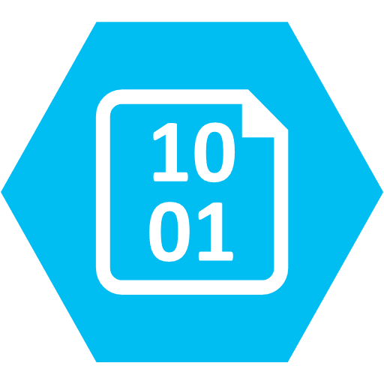
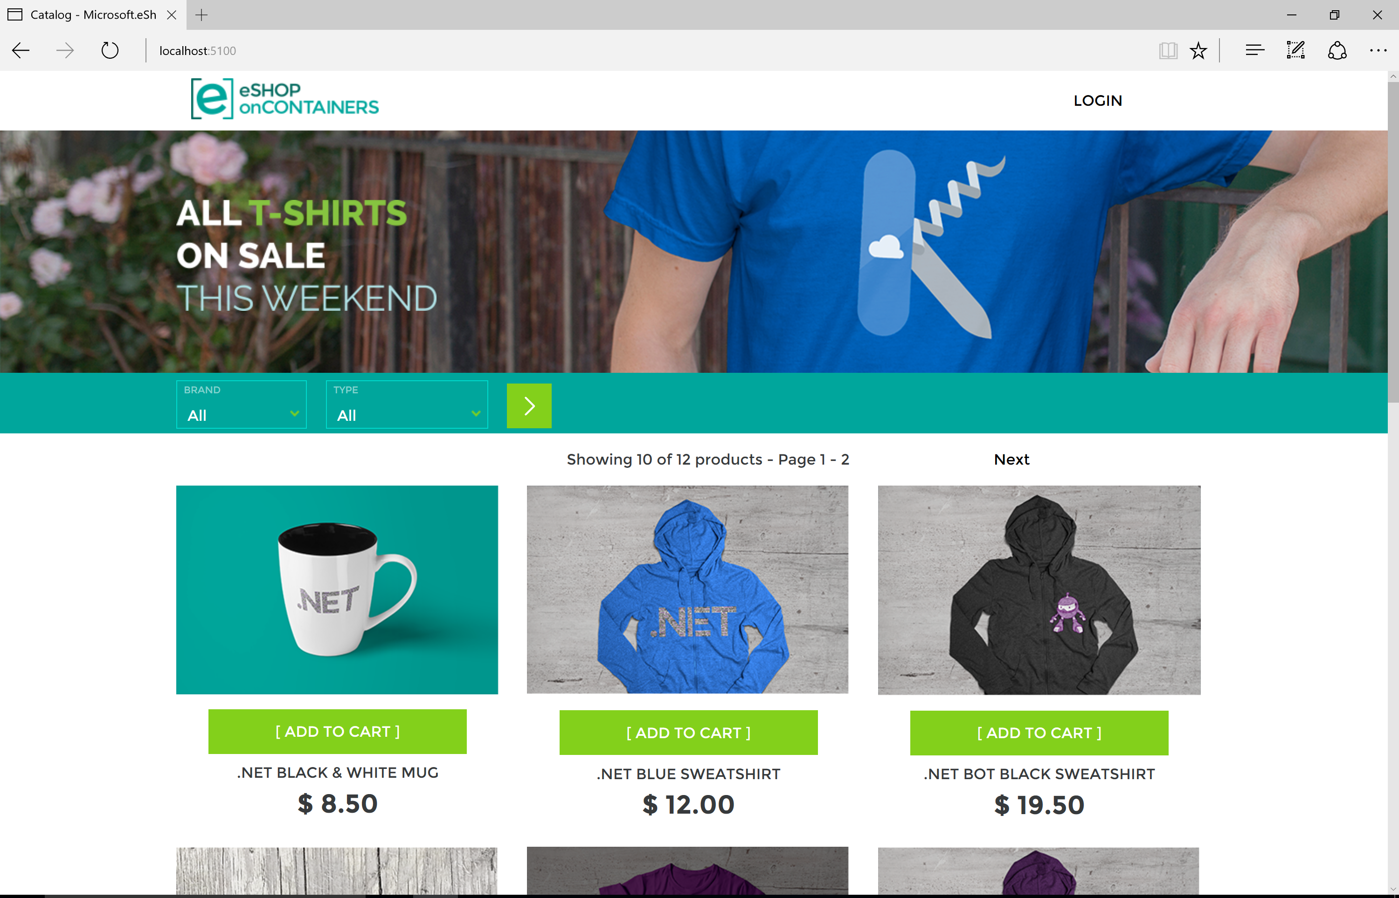


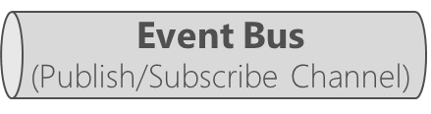
Architecture : eShoponContainers → in Azure
Client apps
Orchestrator in Azure
Azure – High Available application infrastructure as PaaS cloud
Azure Kubernetes Service (AKS)
Identity microservice
(STS+users)
or
Azure SQL Database
Azure Redis
eShop mobile app
Azure Service Fabric
Xamarin.Forms
C#
xPlat. OS:
iOS
Android
Windows
API Gateways/BFF
Catalog microservice
(Basket)
Mobile-Shopping
Ordering microservice
Azure Cosmos DB
Azure Storage - Blobs
Ordering.API
(Product
Images)
SignalR Hub
eShop traditional Web app
Mobile-Marketing
Ordering.BackgroundTasks
eShop WebApp MVC
Basket microservice
Other Azure infrastructure
ASP.NET Core MVC
Web-Shopping
HTML
Marketing microservice
Azure Container Registry
Azure Container Build
Application Insights
Azure Key Vault
Azure API Management
Azure Application Gateway
Azure Dev Spaces
…
eShop SPA Web app
Azure
Service Bus
Locations microservice
Web-Marketing
TypeScript/Angular
https://github.com/dotnet-architecture/eShopOnContainers
Notes:
We selected this application because it’s is an example reference architecture for microservices on Azure. Maintained by .NET foundation
Extended the sample to include DevOps pipeline and code promotion and active-active geo resiliency
Sample Contains
Xamarin client for reference – not demo’ed
Modern single page app and an MVC application ; focus on MVC application and services layer
Independently scalable microservices
No tight coupling between microservices ; cataloging/ordering for example are independent microservices and have their data persistence
Price change fires an event in the service bus which subscribed to the basket service to update prices of items which people have in the cart but have not yet purchased

